Slide 1
T99X171.00 Mechanical Damage FA Risk Assessment For RMA Product Report
VN-JBD- ALT CFT
Date: 2024.10.03

Slide 2
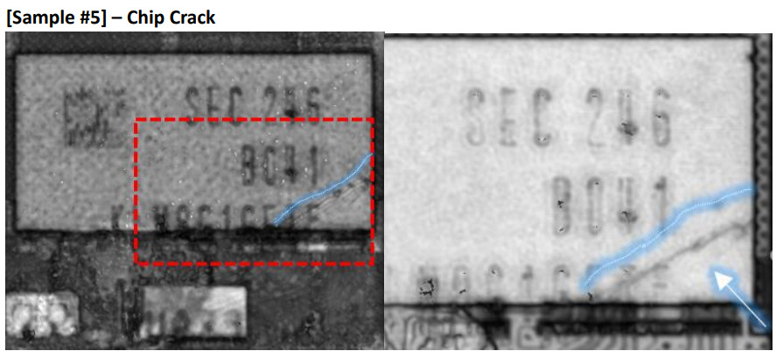
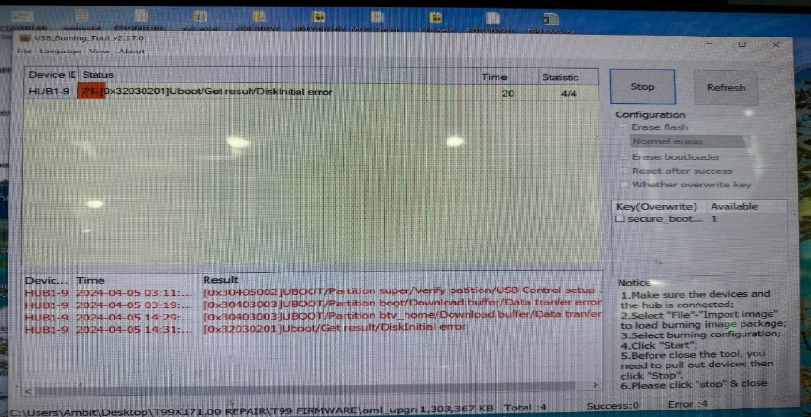
#1
T99X171.00 FA report on mechanical damage risk
ALT customer feedback that they found out Top2 abnormal issue is: Product boot up fail and can't download Factory FW stop 7%
Fii analysis This issue follow eMMC U602 (P/N: 067.00140.005, Vendor: SAMSUNG) material fail.
Samsung vendor analysis eMMC abnormal FA report write cause IC mechanical damage.
FXN factory has re-check all process from SMT to FATP all IC mechanical damage risk. Pls help check it.
Download FW Stop 7%
Chip crack
Summary: There is 1 defective product that has been verified as an initial defect due to mechanical damage caused by some external stress.

Slide 3
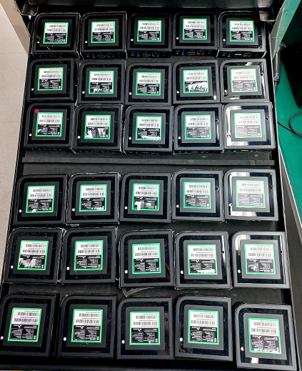
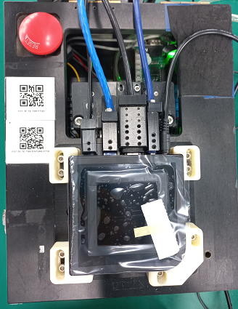
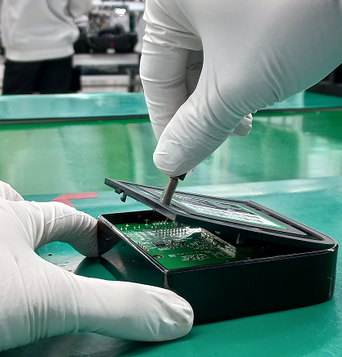
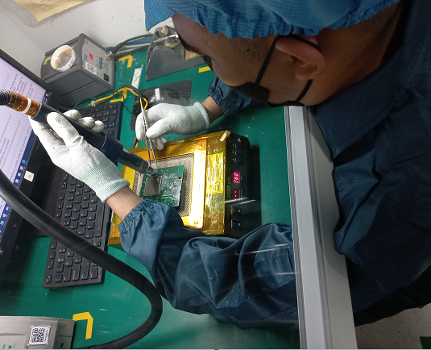
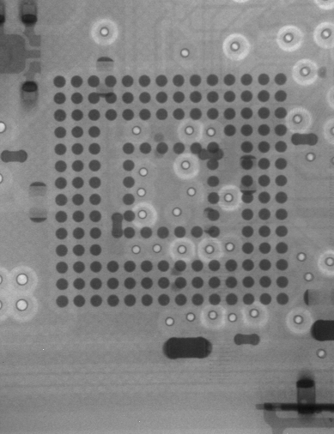
#2
T99X171.00 FA report on mechanical damage risk
T99X171.00 Check RMA process mechanical damage risk assessment
The Fii factory checked the rework process of RMA products to find the risk of mechanical damage.
RMA warehouse
Remove Rubber
Baking products
Sorting products
Remove housing
Analyzes defects
Repair
Xray repaired location
ASSY
Test
Packing
Remove the rubber then place the product in the tray and baking at 45 degrees for 24 hours.
Sorting defective products by Plugging in power supply, Ethernet & HDMI wire
Use tool to remove bottom cover
Analyze defect causes and repair defective products.
Check the repaired position with CCD or X-ray.
Summary: At RMA stage ( Baking, open housing change LED, close housing ) => there are no risk of mechanical damage.

Slide 4
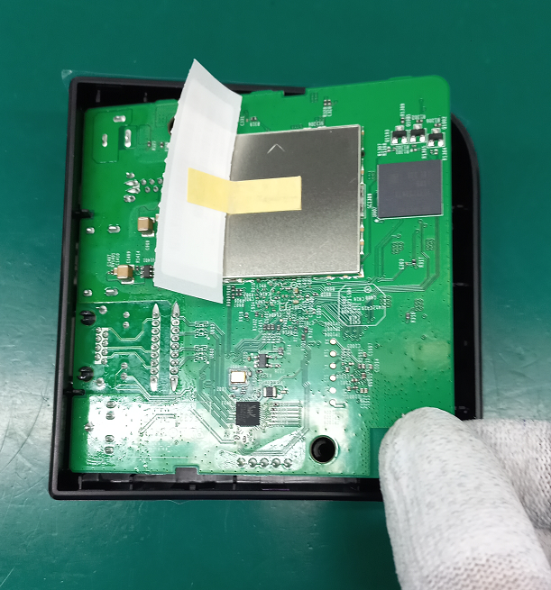
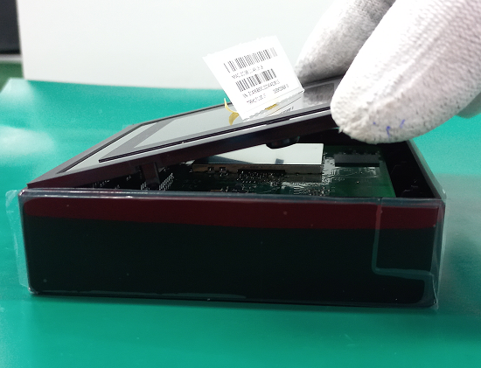
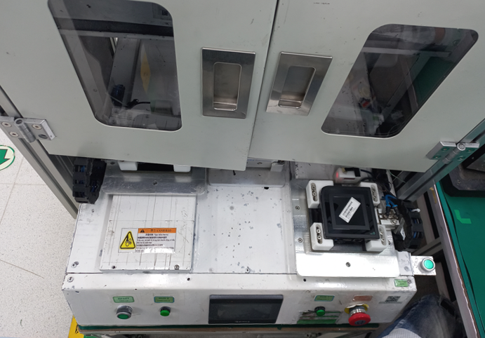
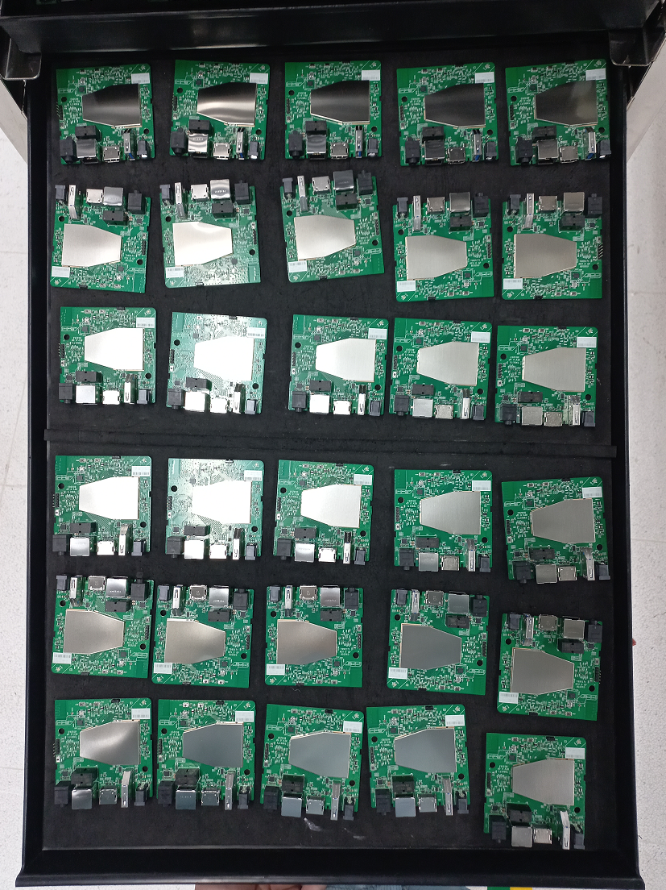
#3
T99X171.00 FA report on mechanical damage risk
T99X171.00 Check RMA process mechanical damage risk assessment
ASSY stage:
eMMC
eMMC
PCBA placed on tray, eMMC in contact with foam mat, no risk of collision.
Assemble PCBA into Top cover, OP does not touch eMMC when operating.
Assemble bot cover into top cover, OP places the edge of bot cover on the connector port side first.
Fasten screw by automatic screwdriver
Summary: At Re-assembly stage, there are no risk of mechanical damage.

Slide 5
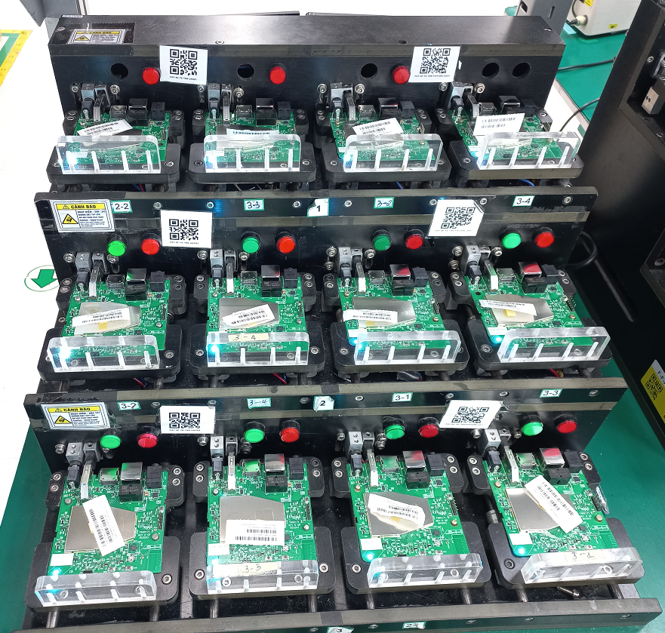
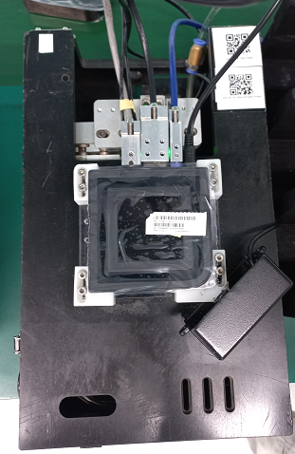
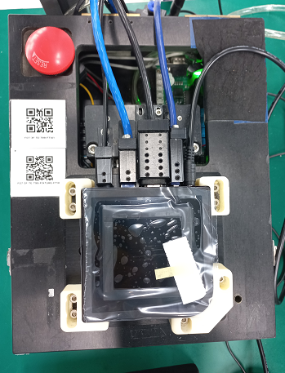
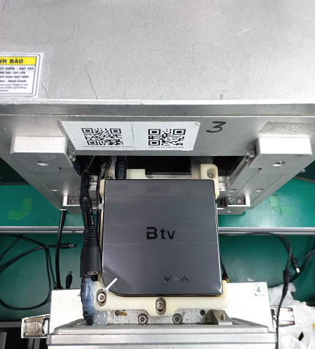
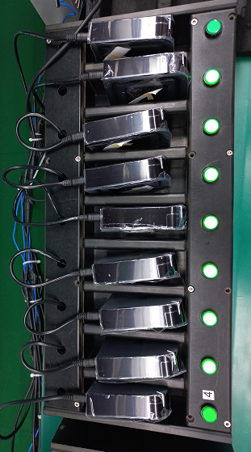
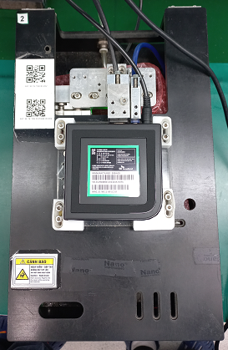
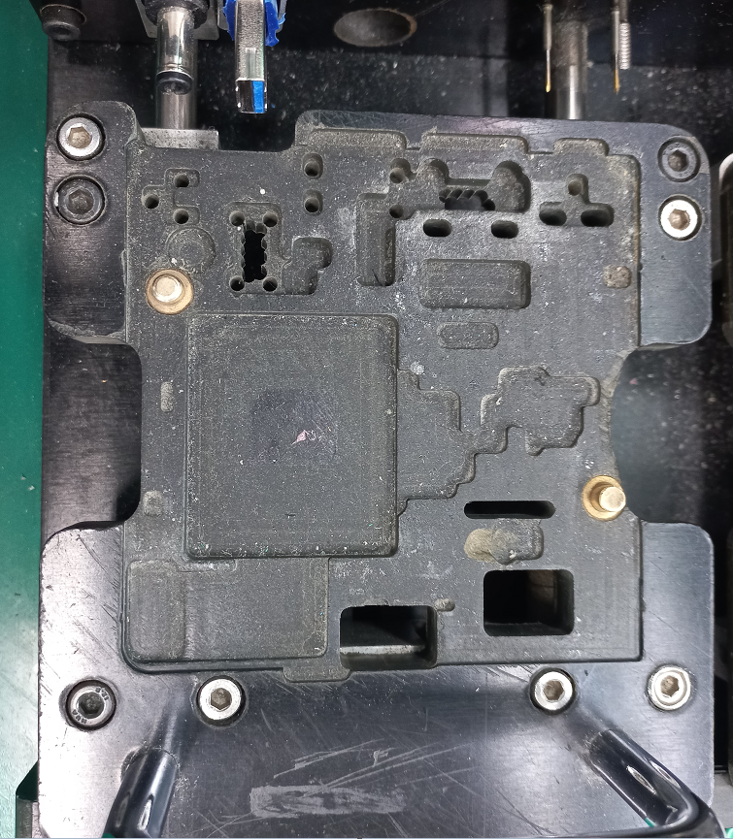
#4
T99X171.00 FA report on mechanical damage risk
T99X171.00 Check RMA process mechanical damage risk assessment
Check TEST stage:
eMMC
location
UK station mold is designed to avoid collision with components.
Test machine
Summary: All Test station mold is designed to avoid collision with components. => No have risk damage IC at all test station.

Slide 6
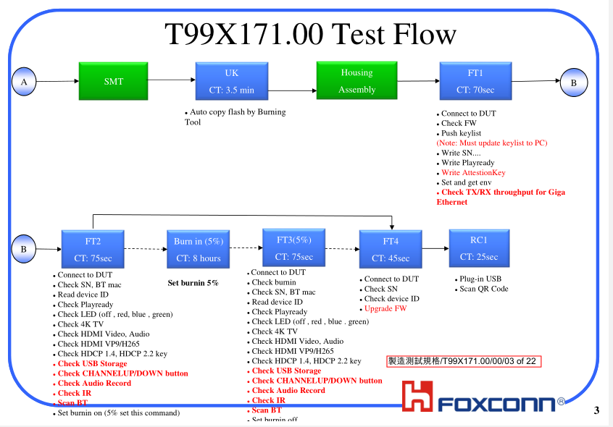
#6
T99X171.00 Mechanical Damage Risk Assessment Report
No Boot FATP Test Coverage:
Summary :
No boot then can’t test at all station ➔ No boot can cover 100% at FATP

Slide 7
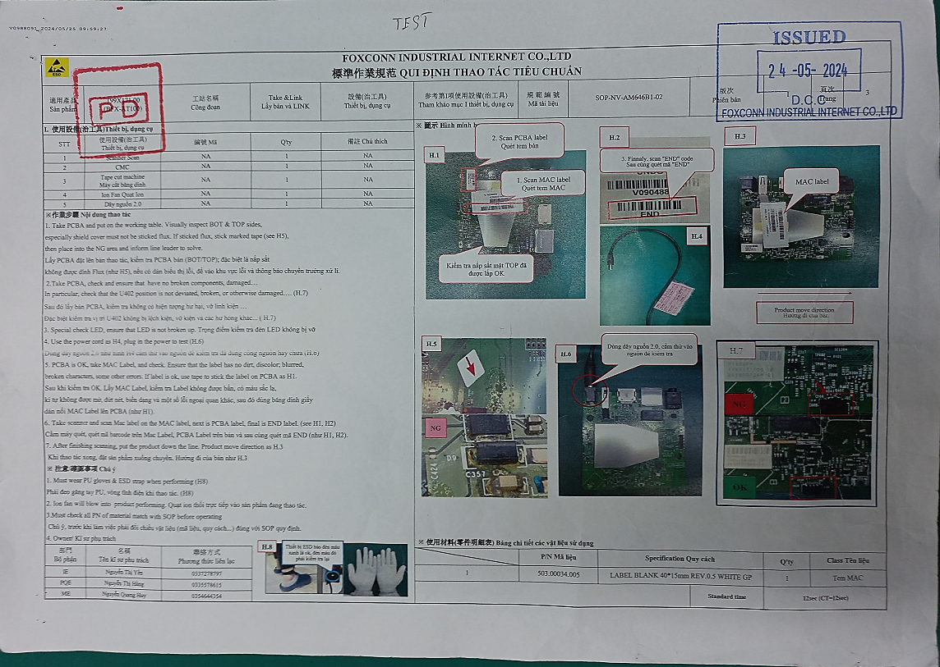
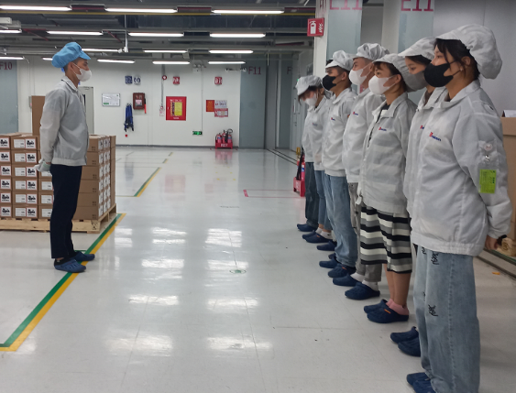
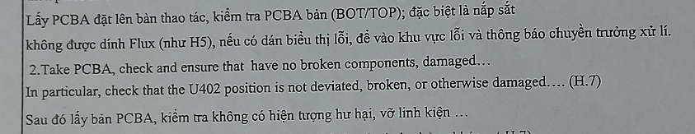
#6
T99X171.00 Mechanical Damage Risk Assessment Report
Conclution
Check the production process no found the risk of mechanical damage.
At the stages of working with PCBA, especially station VI at SMT, PTH, ASSY are all defined in the SOP requiring inspection to ensure no broken components, damage,...
Operators are always trained to check PCBA before and after operation, how to place products into molds, trays and housing to avoid component damage.
The possibility of mechanical damage during production is very low.
Mechanical damage may occur during product use (dropping, impact, etc.)
SOP defined check and ensure no broken component or damage
PD trained OP

Slide 8
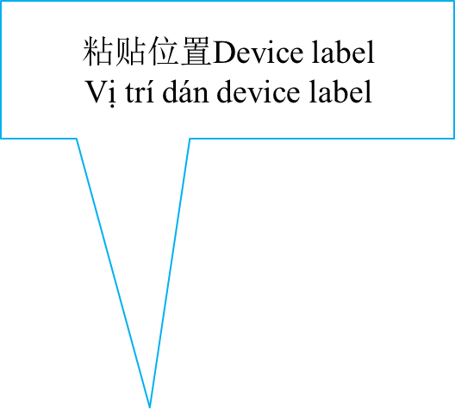
Thank you

